Slide 1
Welcome to the Music Melody Presentation!
Discover the exciting world of music streaming and explore the key features and functionalities

Slide 2
Objective
Our goal is to create a user-friendly and feature-rich music streaming application that provides an exceptional music listening experience.

Slide 3
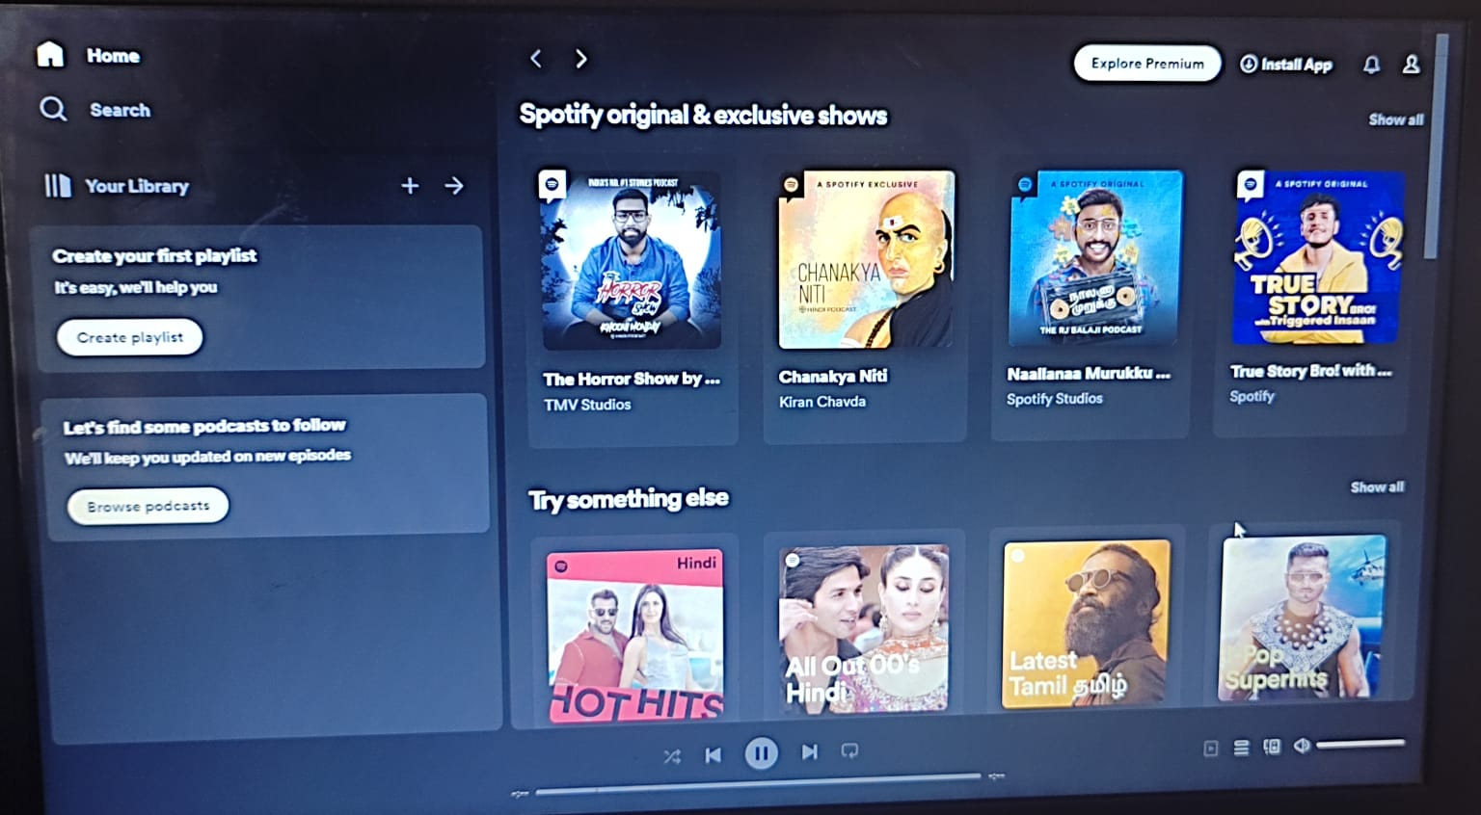
Demo of the Music Melody

Slide 4
Responsive Design
The platform has been meticulously designed to offer a consistent and optimized experience across devices of all screen sizes.

Slide 5
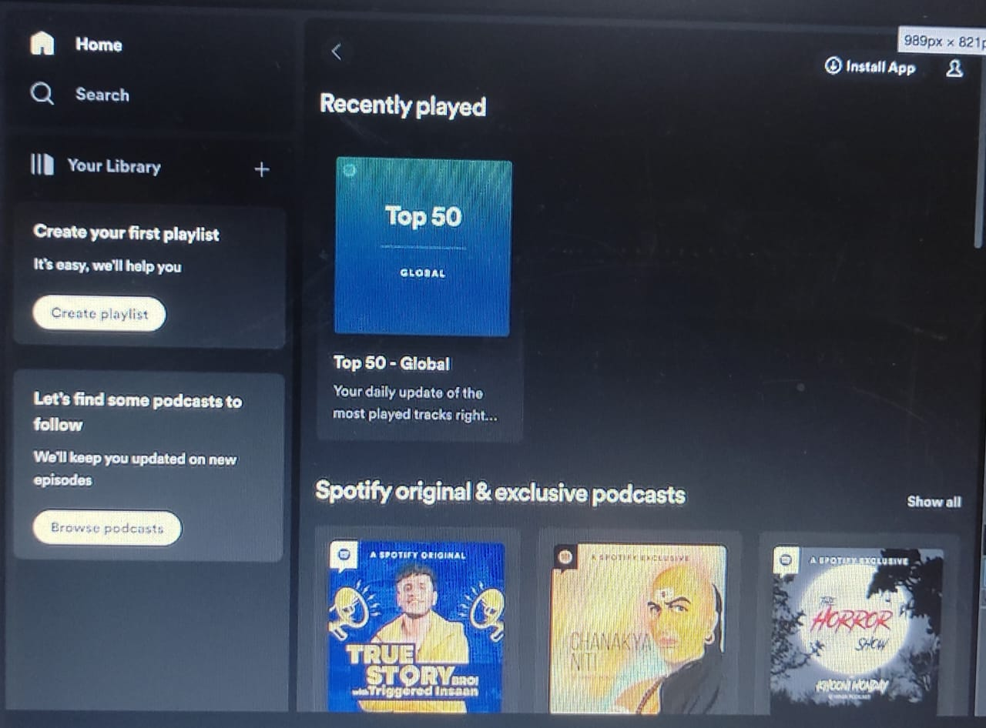

Slide 6
Future Plans and Potential Improvements
Feature Expansion
We have a roadmap for incorporating additional features such as lyrics display and offline listening.
User Feedback
We highly value our users' suggestions and feedback, encouraging them to actively contribute to the platform's improvement.

